Slide 1
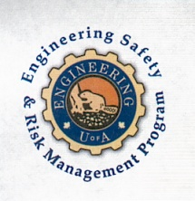
On Becoming a Leader in Risk Management
Fundamentals of RM
RM System and Process
Leadership in RM
Incident Investigation
RM Tools & Challenges
RM in Industry
People & Org.
Applications & Perspectives
ENGG404 - Lecture
Chapter 1.1: The Engineer’s Survival Guide (Part 1)
ESRM-LRM
1

Slide 2
Learning Outcomes:
State the Four Key Points of the Engineer's Survival Guide.
Examine and connect the lessons learned in the case studies to the key principles of the Engineer’s Survival Guide.
Judge a situation where issues/concerns are evident or perceived, in order to make a decision or recommendation.
Make decisions in an enabled and empowered manner, when faced with confusing or conflicting or incomplete information, guidance, direction, or messaging, and often under significant time constraints.
Chapter 1.1: The Engineer’s Survival Guide
2

Slide 3
The Survival Guide:
Is based on the experiences of a highly successful engineer.
Endorsed … by many who have learned the hard way …
Experienced-hardened wisdom …
In class, keep The Engineer’s Survival Guide in mind when reviewing case studies.
In your careers, help you avoid making a poor decision …
The Survival Guide will be introduced with an example:
Chapter 1.1: The Engineer’s Survival Guide
3

Slide 4
The Engineer’s Survival Guide:
Understand company values!
Understand your program!
When you make decisions, put safety ahead of any other objective!
Pay attention to failures in safety systems and take action!
Memorize these Four Key Points!
Chapter 1.1: The Engineer’s Survival Guide
4

Slide 5
What is the Value in The Guide?
Unfortunately, disasters have happened.
Decisions made with the with the best of intentions … … ended in disaster far beyond envisioned.
None set out to cause harm.
These people tragically understood the impact of their decisions after the fact.
It is our express intent that you apply sound risk management principles, that none of you becomes central to a tragic incident, and that none of you becomes the author of a future case study in engineering safety and risk management.
Chapter 1.1: The Engineer’s Survival Guide
5

Slide 6
1) Understand company values! Review company policy (core values and corporate ethics) and determine if safety is a value. When safety is a value – NOT a priority – it supports sustainable ESRM. Values are the compass. Check if the company has a safety culture where:
safety considerations come ahead of any action to complete a task;
safety considerations are the basis for decision making when considering a course of action.
Chapter 1.1: The Engineer’s Survival Guide
6

Slide 7
2) Understand your program! Determine if the company has a safety and risk management program. Understand your personal responsibilities to meet program requirements. Undertake those responsibilities diligently. People’s lives and your company’s business may depend on it.
Chapter 1.1: The Engineer’s Survival Guide
7

Slide 8
3) When you make decisions, put safety ahead of any other objective! Even under stressful circumstances or time constraints, safety takes precedence over:
Production,
Cost,
Schedule,
and any other competing objective.
When we only prioritize safety – “when it takes a backseat” – we expose people, the environment, and the company to increased risk.
Chapter 1.1: The Engineer’s Survival Guide
8

Slide 9
4) Pay attention to failures in safety systems and take action!
You must intervene when there are deviations and variances in the intended engineering controls and/or the administrative controls i.e. bypassed, deactivated, circumvented, etc. You must work to correct these deviations and variances / sub-standard conditions and sub-standard work practice. Accepting these variances means you will be part of the inevitable spiral to disaster, and you don’t want to be the author of your own case study.
Chapter 1.1: The Engineer’s Survival Guide
9

Slide 10
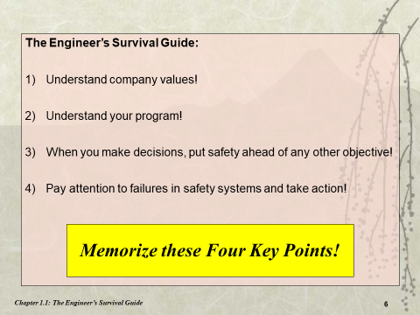
The Four Key Points of the ESG:
How To Apply the Key Points:
The Key Points can be applied in any situation for any decision-making process e.g. a case study or a dilemma in the workplace.
The purpose is to make a decision or recommendation consistent with the Engineer’s Survival Guide,
Given the available data, information, and resources In order to maximize or optimize the realization of a desired outcome or acceptable condition.
Midterm & Final Exam Q#1:
Midterm & Final Exam Q#2:
Chapter 1.1: The Engineer’s Survival Guide
10

